Slide 1

$$ε−NFA$$

Slide 2
NFA with Ɛ- Transition
0
1
q0
ε
q1
We extend the class of an NFA by allowing ε transitions:
The automaton may be allowed to change its state without reading the input symbol.
Such transitions are depicted by labeling the appropriate arcs with ε.
‘ε’ does not belong to any alphabet (∑).

Slide 3
Why Ɛ- NFA ?/
ε -NFAs add a convenient feature.
Through ε –NFAs we can implement some complex languages easily.
They do not extend the power of an NFA.
Both NFAs and ε-NFAs have same power.

Slide 4
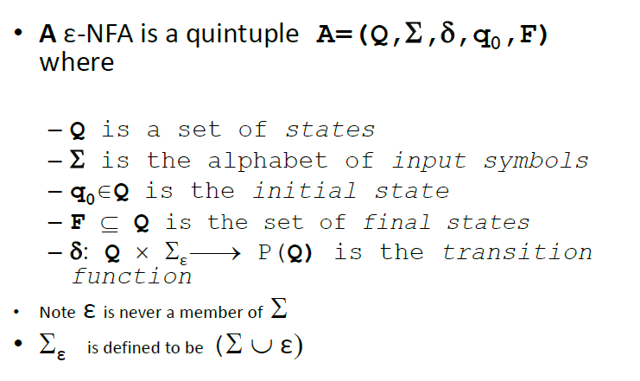
Definition

Slide 5
ε -NFAs add a convenient feature but (in a sense) they bring us nothing new: they do not extend the class of languages that can be represented. Both NFAs and ε-NFAs recognize exactly the same languages.
We can allow state-to-state transitions on ε input.
These transitions are done spontaneously, without looking at the input string.
A convenience at times, but still only regular languages are accepted.

Slide 6
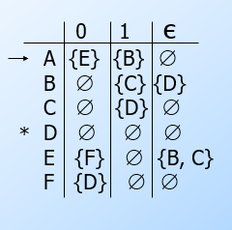
Example
ε
1
1
1
B
C
D
A
ε
ε
0
0
E
F
0

Slide 7
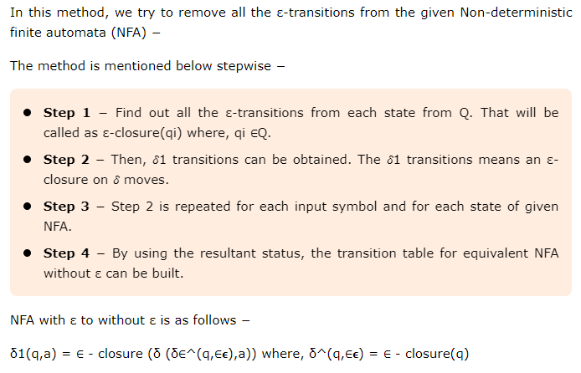
Conversion of ε –NFA to NFA
* All states that have Final state of ε –NFA​ in their null closure are final states.

Slide 8
ε –Closure of a state
The ε-closure of the state q, denoted as ε-Closure(q), is the set that contains q, together with all states that can be reached starting at q by following only ε-transitions.
a
b
c
q0
ε
q1
ε
q2
ε-Closure(q0) = {q0, q1, q2}
ε-Closure(q1) = {q1, q2}
ε-Closure(q2) = {q2}

Slide 9
Conversion of ε –NFA to NFA
a
b
c
δ(q0, a)= ε-Closureδ(ε-Closure(q0), a)
= ε-Closureδ({ q0,q1,q2},a)
= ε-Closure(q0)
= {q0, q1, q2}
q0
ε
q1
ε
q2
States | ε-Closure
q0 | {q0, q1, q2}
q1 | {q1, q2}
q2 | {q2}
 | a | b | c
q0 | {q0, q1, q2} | {q1, q2} | {q2}
q1 | φ | {q1, q2} | {q2}
q2 | φ | φ | {q2}
a
b
c
q0
a, b
q1
b, c
q2
a, b, c

Slide 10
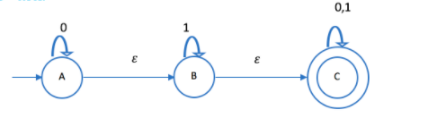
Question-1

Slide 11
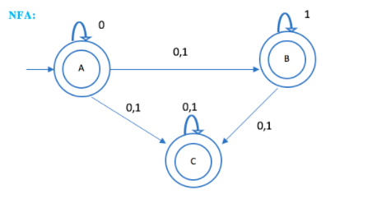
Solution-1

Slide 12
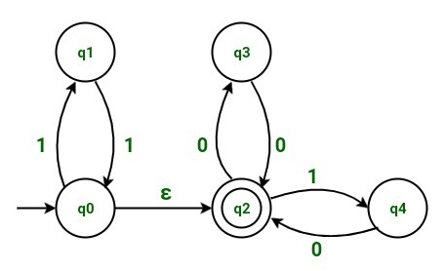
Question-2

Slide 13
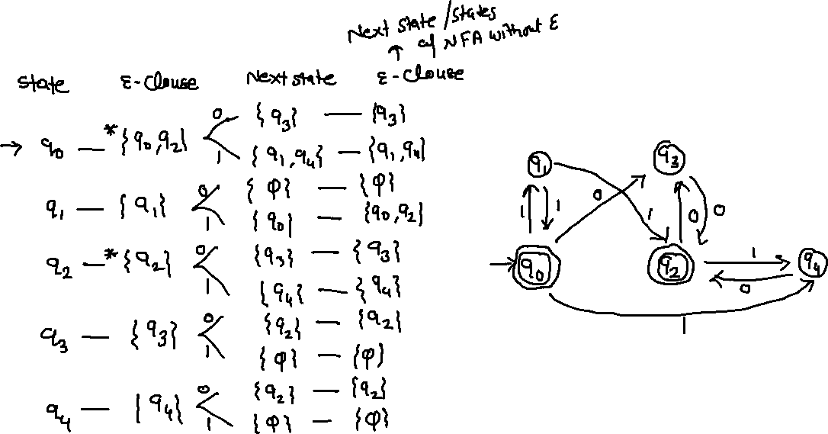
Solution-2

